Slide 1
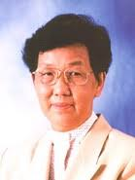
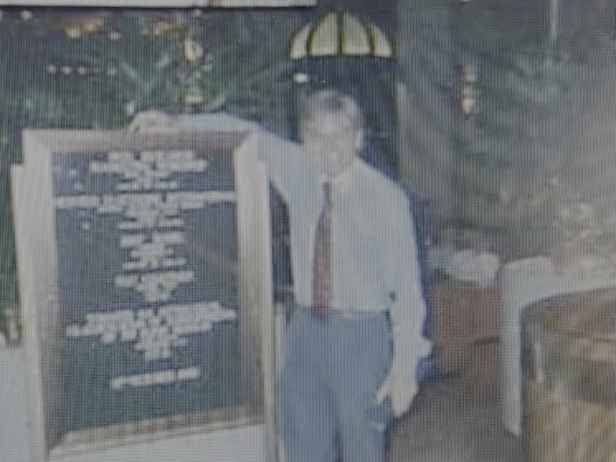
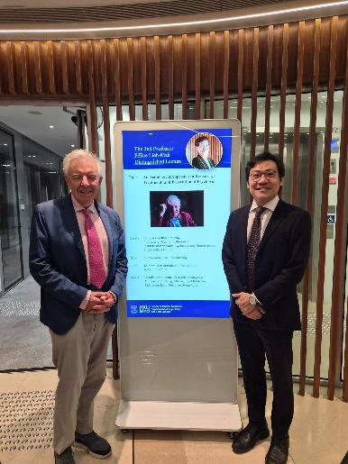
Professor Felice Lieh-Mak
An Aetiological Approach to
Understanding and Treating Psychosis

Slide 2
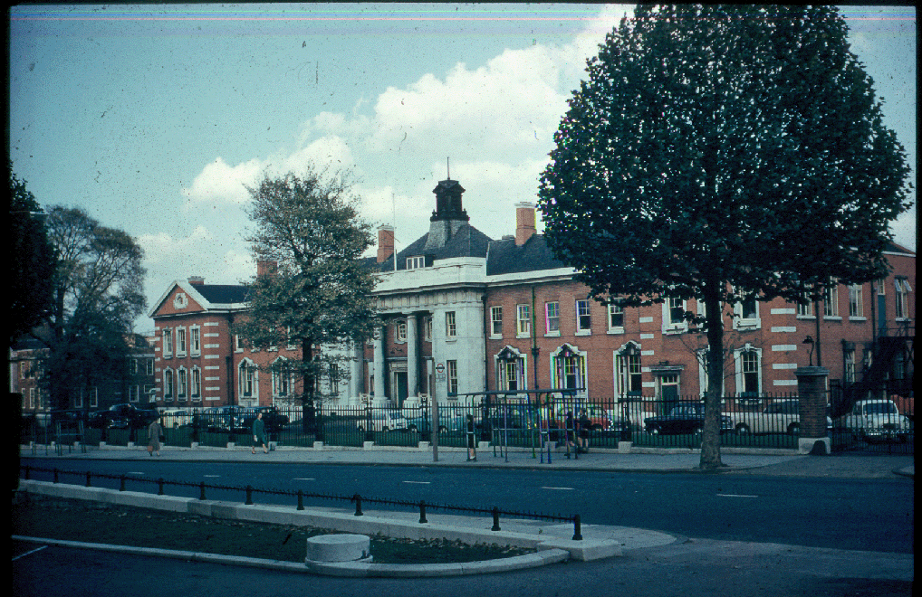
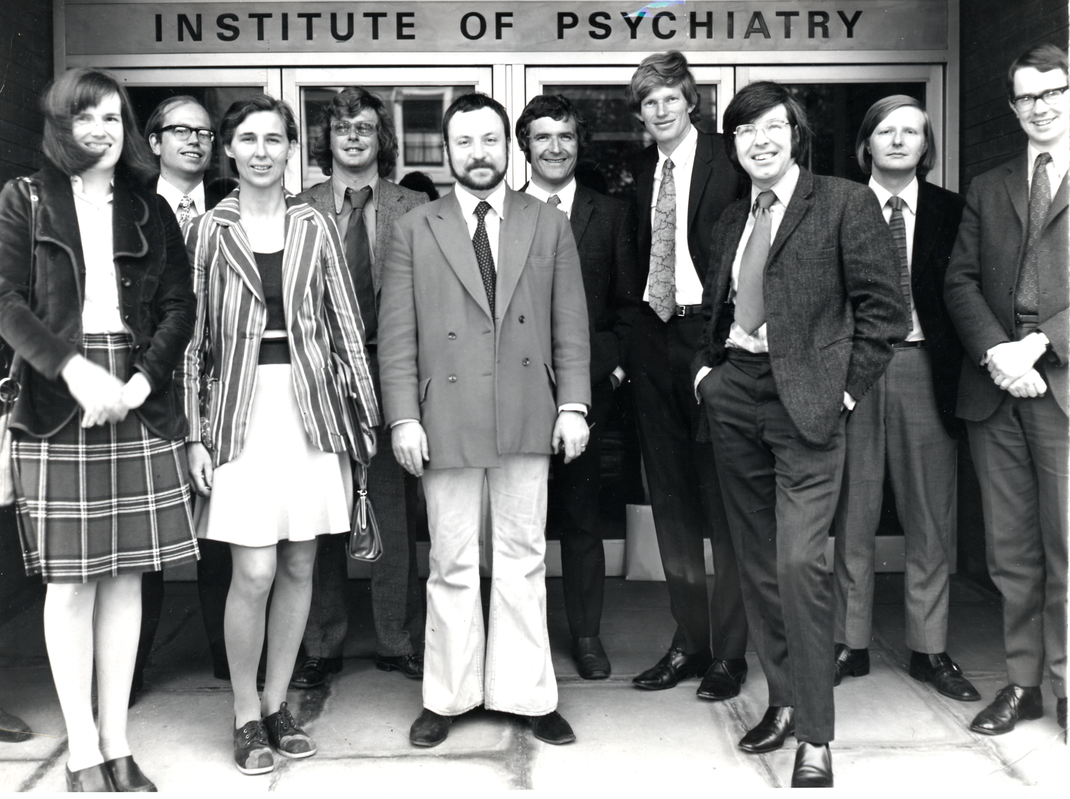
Maudsley Hospital - 1972

Slide 3
Is there a neurochemical basis to schizophrenia?

Slide 4


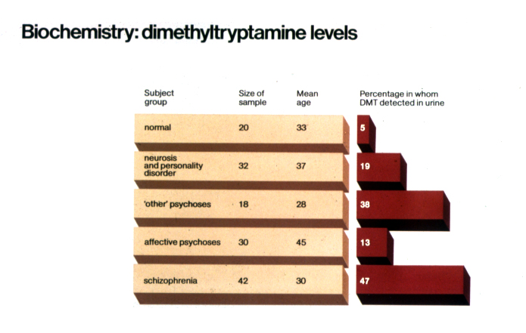
Is schizophrenia caused by endogenous hallucinogens?
Dimethytryptamine (DMT) - isolated from the plants used by Amazonian Indians in their Mystical Rituals
Rodnight R, Murray RM et al Psychological Medicine, 1976, 6, 649-657

Slide 5
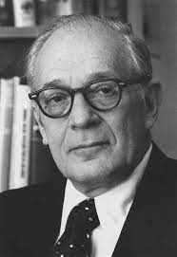
“Studying the urine of patients with schizophrenia in order to discern the neurochemical basis of psychosis is like examining the sewers of the Kremlin in an attempt to understand the policies of the Soviet politburo”
Seymour Kety 1976 APPA

Slide 6
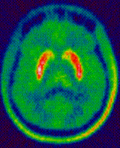
Striatal Dopamine Synthesis is Elevated in schizophrenia and mania
This is the final common pathway to psychosis
Jauhar et al JAMA
Psychiatry Dec 2017

Slide 7
Is there a genetic basis to schizophrenia?

Slide 8
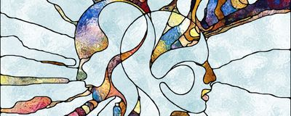
Seymour Kety 1976
Schizophrenia results from a single major gene with partial penetrance
BUT IS THIS TRUE?
Notes:
8

Slide 9
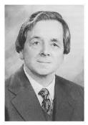
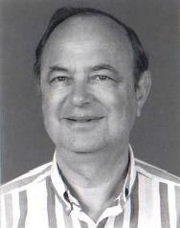
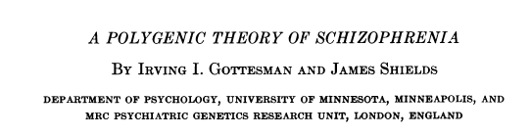
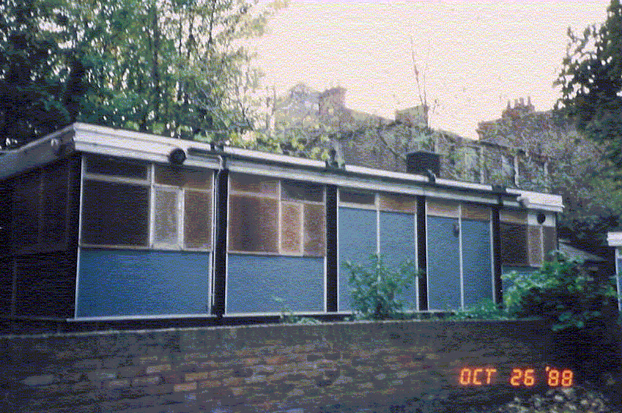
The Genetics Hut
Institute of Psychiatry
London
980 citations
1967
This unorthodox view was ignored for 50 years, as researchers searched
unsuccessfully for the elusive single gene.

Slide 10
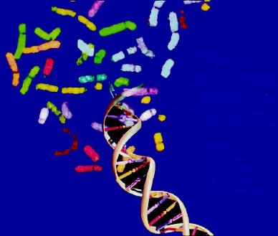
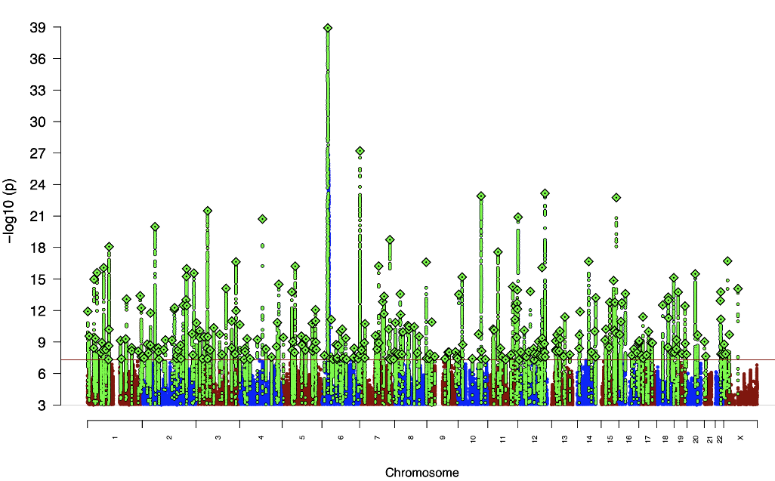

74,776 schizophrenic patients and 101,023 controls
263 genome wide significant sites
Largest GWAS Study
of Schizophrenia
Vulnerability to schizophrenia is
Polygenic.
Gottesman and Shields were proven
right after more than 5 decades!!
Trubetskoy et al Nature April 2022

Slide 11
Is the brain abnormal in schizophrenia?

Slide 12
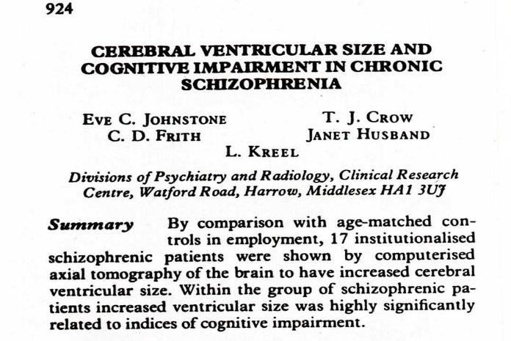
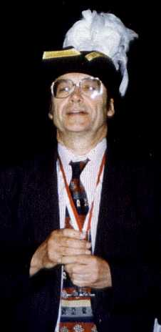
The man who changed the face of schizophrenia research
1693 citations
The brain structural abnormalities and cognitive impairment were taken as evidence that Kraepelin was right in saying that schizophrenia was a progressive brain disease

Slide 13
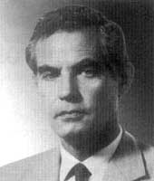
THIS STUDY CHANGED THE WAY THAT SCHIZOPHRENIA WAS VIEWED:-
Schizophrenia is a discrete disease
It is a brain disease
It is a progressive degenerative disease
Social theories were abandoned
“…longterm neuroleptic therapy could explain some of the cerebral atrophy and related cognitive impairment demonstrated by Dr Johnstone and her colleagues”
Bur is the finding correct? Yes but the interpretation isn’t!
MARSDEN CD Lancet, 1976, 2, 1079

Slide 14
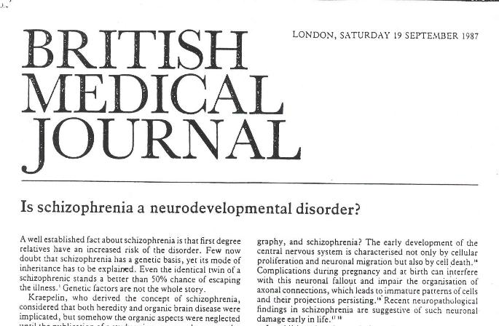
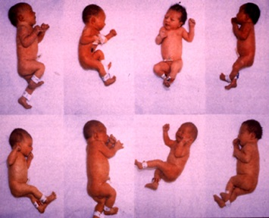
In 1987 we suggested that the brain changes were developmental rather than degenerative
SW Lewis and RMMurray
Over the next two decades it became accepted that the brain abnormalities were
neurodevelopmental and not neurodegenerative

Slide 15


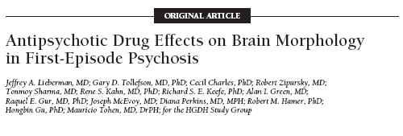
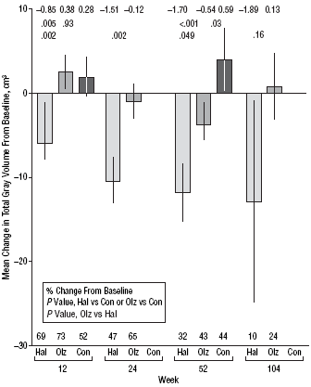
However, in 2005, the pessimistic Kraepelinians began to rise from the grave!
Schizophrenia causes loss of grey matter volume and this is prevented
by olanzapine but not haloperidol
Haloperidol causes loss of grey matter volume but olanzapine doesn’t

Slide 16

Now we know that there are subtle brain changes in some people with schizophrenia before the onset of the illness i.e. they are developmental. But after onset, the brain changes may be exacerbated by the life experiences of the patient; antipsychotics, drug abuse, tobacco, metabolic syndrome, hypertension, diabetes, poverty, homelessness, poor diet
I.E. MARSDEN WAS PROVEN RIGHT (POSTHUMOUSLY)

Slide 17
Is the incidence of schizophrenia the same everywhere?

Slide 18

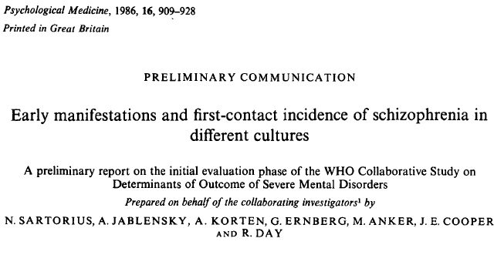
“These results provide strong support for the notion that schizophrenic illnesses occur with similar frequency in different populations”
BUT IS THIS TRUE?

Slide 19
ÆSOP – epidemiological study of first-episode psychosis in three English Cities
All individuals 16-65 years living in three defined city areas who presented to psychiatric services with their first psychotic episode
Incidence rate for schizophrenia per 100,000
London 20.1
Nottingham 7.7
Bristol 7.2
Nottingham
South East
London
Bristol
This confirmed many other studies showing that the incidence of schizophrenia is higher in big cities
BUT IS THIS TRUE?

Slide 20


Incidence of first episode psychosis across Europe
70
61.64
60
London
50
47.44
44.71
Amsterdam
Paris
40
30
24.83
22.08
19.68
21.95
20
17.17
15.9
18.53
17.7
12.66
11.2
10
6.3
0
London
Amsterdam
Madrid
Santiago
Oviedo
Clermont Ferrand
Verona
Cambridge
Leiden
Barcelona
Valencia
Paris
Bologna
Palermo
Jongsma et al. JAMA Psychiatry 2018
The higher incidence in cities only holds in the
Northern Cities. Why?

Slide 21

Relationship between the frequency of cannabis use and the rate of psychosis
Prevalence of daily cannabis use in population controls (%)
Adjusted psychosis incidence (rate per 100,000)
20
60
50
15
40
Prevalence of daily cannabis use in population controls (%)
Adjusted psychosis incidence (rate per 100,000)
10
30
20
5
10
r=0.8, p=0.0109
0
0
London
Cambridge
Amsterdam
Gouda & Voorhout
Madrid
Barcelona
Paris
Bologna
Palermo
BUT IS THIS TRUE OR A
STATISTICAL ARTEFACT?
Di Forti et al, Lancet Psych, On Line March 23 2019

Slide 22

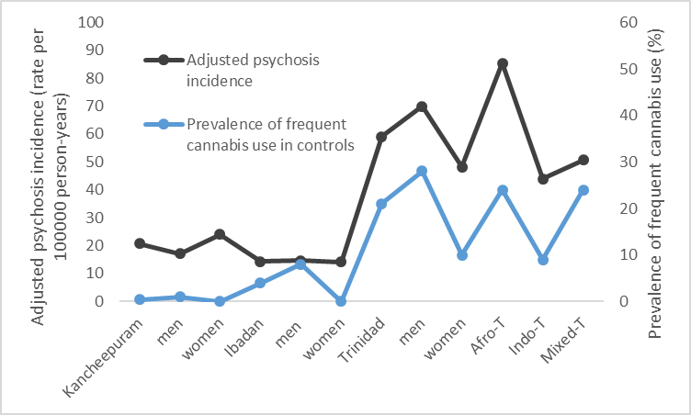




Association between prevalence of frequent cannabis use and incidence of psychoses
Joni Lee Pow et al Psychological Medicine 2023

Slide 23

1965-1968
1969-1972
1973-1977
1978-1982
1983-1987
1988-1992
1993-1997
2010-2012
Boydell J Psychol Med. 2006, 36,1441-6
Quattrone D Unpublished data

Slide 24
The incidence of schizophrenia varies widely by geography and time according to the prevalence of risk factors.

Slide 25
Is schizophrenia a deteriorating disease?

Slide 26
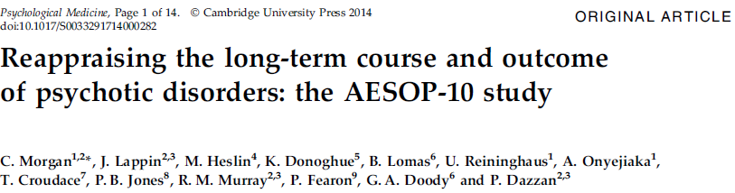
AESOP, Aetiology and Ethnicity in Schizophrenia and Other Psychoses
Morgan et al. Psychol Med 2014;44:407–419

Slide 27
How were 387 patients functioning at ten years?
65% had no psychotic symptoms at 10 years
46% had had none for >2 years (40% of those with a diagnosis of Schizophrenia)
21% overall and 19% of people with schizophrenia
had no psychotic symptoms and were not taking antipsychotics
Morgan et al. Psychol Med 2014;44:407–419

Slide 28
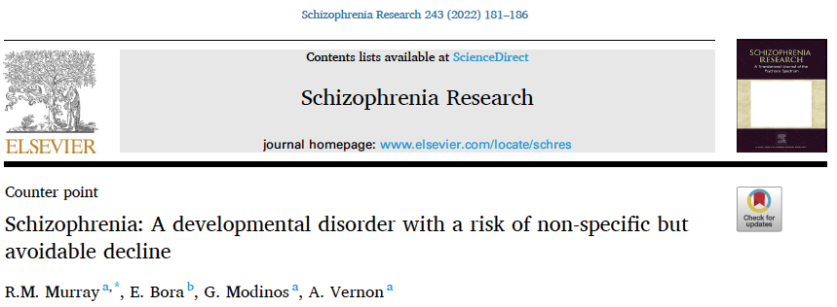
We carried out 2 meta-analyses showing that there is on average no cognitive decline in the 10 years after the onset of schizophrenia

Slide 29
What was the treatment in 1972?

Slide 30

All antipsychotics target the D2 receptor
Dopamine release
Dopamine synthesis capacity
Psychosis
Antipsychotics eg chlorpromazine, haloperidol
Howes, et al. Curr Pharm Des 2009;15:2550–2559

Slide 31
What is the treatment in 2025? Largely the same but with atypical antipsychotics. What about 2026?

Slide 32
All antipsychotics target the D2 receptor
Dopamine release
Dopamine synthesis capacity
Psychosis
Antipsychotics eg olanzapine, aripiprazole
Howes, et al. Curr Pharm Des 2009;15:2550–2559

Slide 33
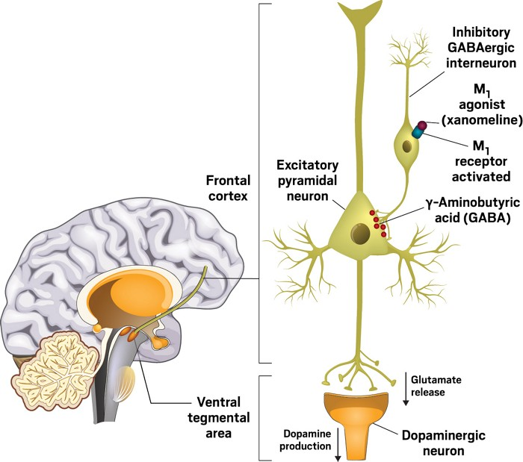
Xanomeline is a muscarinic agonist which activates GABA which inhibits glutamate release and in turn decreases dopamine synthesis
Dopamine synthesis capacity
Dopamine release
Dopamine synthesis capacity

Slide 34
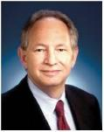
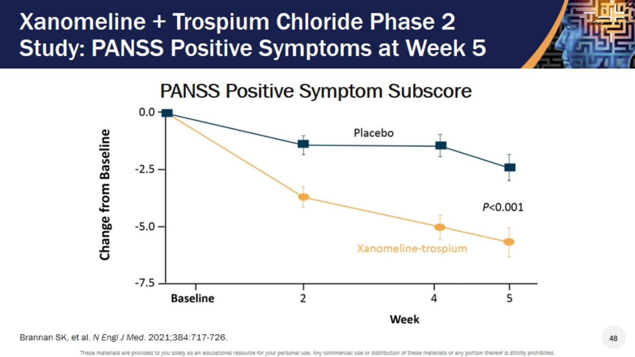
Xanomeline + Trospium Chloride Phase 2 Study: PANSS Positive Symptoms at Week 5
Xanomeline causes nasty GI symptoms – these are blocked by Trospium which is a muscarinic antagonist which doesn’t cross the blood-brain barrier
Cobenfy

Slide 35
What can we learn from cardiologists?

Slide 36
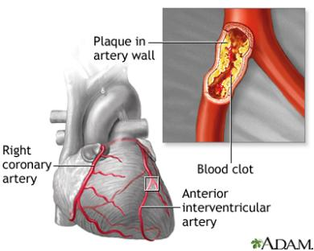
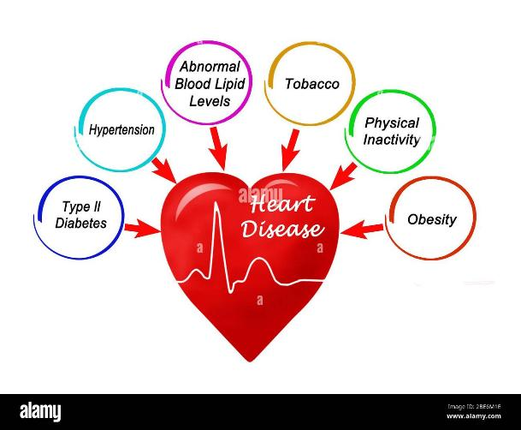
The final common pathway is a clot in a coronary artery. The treatment involves addressing this
An analogy with Coronary Artery Disease.
but also the causes:-
We should think about treating psychosis in the same way

Slide 37
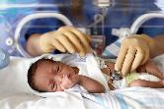


Confirmed Environmental Risk Factors from Meta-analyses*
Neurodevelopmental Risk
Obstetric Events (Davies et al, 2020). 1.5-2.0
Drug Abuse
Cannabis Use. (Marconi et al, 2015)………….>4.0
Social Adversity
Migration/ethnic minority (Tortelli, 2018). 1.5-6
Childhood adversity (Varesse et al, 2012). 3.0
Adverse life events (Beards et al, 2013). 3.4
*Arango et al, 2021

Slide 38
An Aetiological Approach to Psychosis
Genetic Predisposition to Mood instability
Genetic Predisposition to Schizophrenia
Neurodevelopmental Pathway to Psychosis
Social Adversity Pathway to Psychosis
Affective
Psychosis
Bipolar
Depression
Rare Organic Causes
T.L.E
NMDAR
Ab’s
Drug Induced
Psychosis
Hormonal
Post Partum
Menopause

Slide 39

Psychosis arising from Neurodevelopmental Impairment
Genetic Predisposition to Mood instability
Genetic Predisposition to Schizophrenia
Poor premorbid function
Minor physical abnormalities and/or neurological soft signs
Brain structural abnormalities
Negative symptoms and neuropsychological deficit
Worse outcome with excess of
treatment resistance
Neurodevelopmentalpathway to psychosis
Copy Number Variants
Obstetric complications
Cognitive remediation
Assertive community management
Early introduction of clozapine
Polygenic Score for Low IQ

Slide 40
Xanomeline + Trospium Chloride Phase 2 Study: PANSS Positive Symptoms at Week 5
Xanomeline is a muscarinic cholinergic agonist (M1 and M4) but causes nasty GI symptoms – these are blocked by Trospium which is a muscarinic antagonist which doesn’t cross the blood-brain barrier
Cobenfy

Slide 41
Xanomeline is a muscarinic agonist which activates GABA which inhibits glutamate release and in turn dopamine synthesis
Dopamine synthesis capacity
Dopamine release
Dopamine synthesis capacity

Slide 42

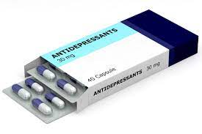


Psychosis Arising from Social Adversity
Genetic Predisposition to Mood instability
Genetic Predisposition to Schizophrenia
Often mediated by depression, anxiety, or PTSD symptoms
Social adversity Pathway to Psychosis
Sexual abuse
Physical abuse
Neglect
Bullying
Childhood
adversity
Adverse Life events
Intrusive
life events
Migration
Discrimination
Before, during, and
after migration

Slide 43

Cognitive Behaviour Therapy for Psychosis
CBT is useful not just for anxiety and
depression but moderately also for delusions
Peters, Hardy et al
Star Trial shows that Trauma-based CBT is highly effective for
psychotic patients who have suffered trauma and have PTSD symptoms
Hardy et al 2022

Slide 44
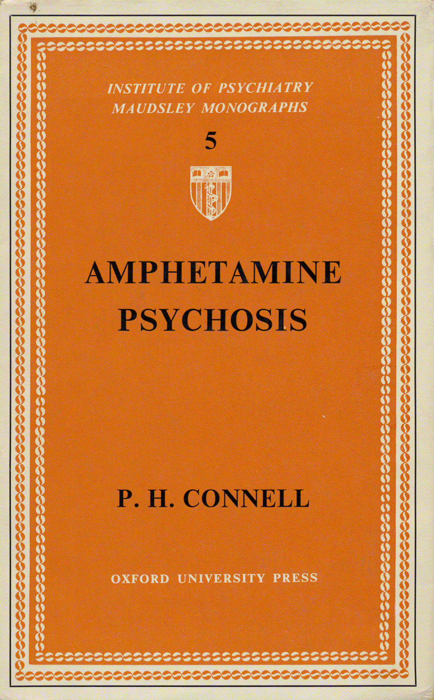
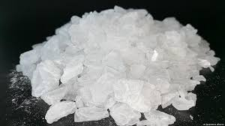


Psychosis arising from Drug Abuse
Genetic Predisposition to Mood instability
Genetic Predisposition to Schizophrenia
Higher premorbid IQ.
Better premorbid function
Earlier onset.
More positive symptoms
Fewer negative symptoms
Worse outcome if continue use.
Drug Induced
Psychosis
Stimulants
Cannabis
What about
tobacco?

Slide 45
An Aetiological Approach to Psychosis
Should facilitate research by enabling us to establish the characteristic clinical and biological characteristics of each risk group without them being obscured by patients whose illness was caused by other risk factors
Will enable us to provide personalize interventions to address the factors that caused onset and relapse of psychosis in a particular patient
Will facilitate preventative approaches

